Slide 1


Sugar Deployment in US Schools
December 11, 2009
Natalia Grigoras Wei Lin
Anna Ivashko Project Manager: George Lee

Slide 2

Engagement Contract
Mission
To create a coherent product introduction and marketing plan for Sugar software.

Slide 3
Objectives
Understand the targeted audience and create a model for Sugar implementation
Understand the barriers currently limiting Sugar software adaption in elementary schools
Study the impact of Sugar software implementation in pilot deployments
Recommend a general strategy for effectively implementing Sugar software in US school systems

Slide 4
Agenda
Methodologies
Findings and Groundwork
Analysis
Sugar on a Stick Implementation Plan
Conclusions and Recommendations

Slide 5
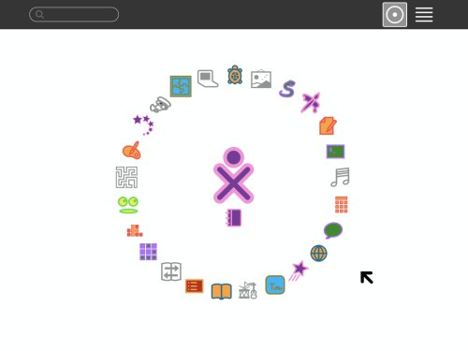
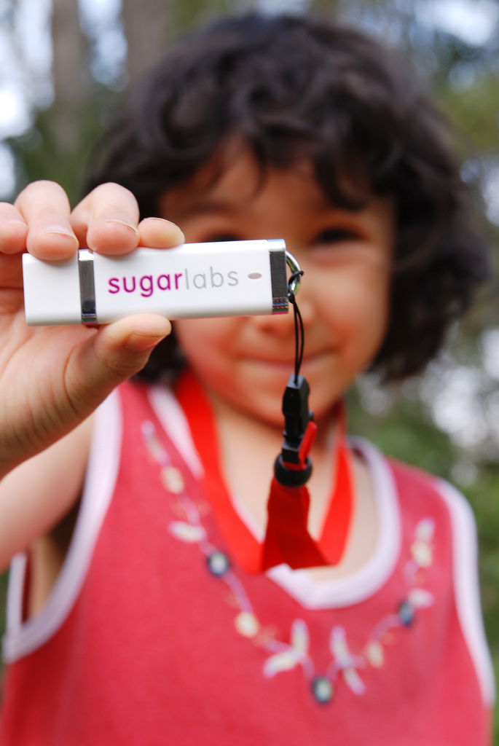
This is Sugar!

Slide 6
Methodologies
Secondary Research
Primary Research
Financial Research
Meeting Observations

Slide 7
Agenda
Methodologies
Findings and Groundwork
Analysis
Sugar on a Stick Implementation Plan
Conclusions and Recommendations

Slide 8
Secondary Research:
School System Demographics
Boston Public Schools (56,186 students)
K-5 25,887 students → 50%
6-8 11,340 students
Ratios:
  1 “modern computer” : 4 students (99% w/ internet)
  1 teacher : 12.8 students

Slide 9
Secondary Research: Teacher Types
Niederhauser’s Teaching and Teacher Education:
Instructivist
“traditional beliefs about teaching with instructional methods”
Constructivist
“explore different strategies in problem solving” to inspire new ways of thinking

Slide 10




Secondary Research:
Sugar Activities
Arithmetic Journal Tam-Tam Speak
Findings:
Wealth of activities but few explanations
Difficulties to categorize

Slide 11

Secondary Research:
State involvement – BIG part of broad level implementation
Teacher training is key!
  Week- Long Institute training
Need the teacher on board!
“[teachers feel they]must always know everything and always be fully in charge”
Proof of success
- Important for funding
Papert, Seymour. "Logo Philosophy and Implementation." Case Study. 1999.

Slide 12
Primary Research: Interviews
Ann Koufman
Caroline Meeks
Gerald Ardito
Michael O’Keefe
Robert McKenna
Barbara Vincent
Rob Stergis
Anne Sudbay
Michael McDermott

Slide 13
Primary Research:
Sugar advantages and disadvantages
Teacher training
Implementation obstacles
Key implementation steps
Other findings

Slide 14
Agenda
Methodologies
Findings and Groundwork
Analysis
Sugar on a Stick Implementation Plan
Conclusions and Recommendations

Slide 15
Analysis
Teachers
Pilot programs
  Grades
  Charter schools
  Foreign language
Tailor to American students
Training

Slide 16
SWOT Analysis
Strengths
Weaknesses
Opportunities
Threats

Slide 17
SWOT Analysis
Strengths
-Customizable and collaborative
-Promote creative thinking
-In-expensive physical device

Slide 18
SWOT Analysis
Weaknesses
-No centralized information hub
-Too “free” for teachers
-Need to incentivize and support teachers

Slide 19
SWOT Analysis
Opportunities
-Technology is a priority
-More and more pilot schools
“Free” software appeal

Slide 20
SWOT Analysis
Threats
-Other free education software and online applications
-Unstable infrastructure may weaken implementation

Slide 21
Pyramid of School System Approaches
States
Superintendents
Principals
Technology Education Teachers
Teachers
Students and Parents

Slide 22
Financial Analysis
Cost of ownership
  MA $6.8 million
No Child Left Behind Title II, Part D
  MA $2 million, 2010
Race to the Top
  MA $100 million, 2010

Slide 23
Agenda
Methodologies
Findings and Groundwork
Analysis
Sugar on a Stick Implementation Plan
Conclusions and Recommendations

Slide 24

Implementation Plan
Steps | Purpose
Step 1: Initial Exposure
Step 2: Validate and Receive Feedback
Step 3: Execute Pilot Testing and Identify Problems
Step 4: Refining the Process
Step 5: Prepare for Wide System Implementation
Step 6: Deploy System
Step 7: Transition of Ownership to the Performing Organization
Spark Interest
Prepare for Pilot Testing
Collect Data
Identify Problems
Analyze Data
Fix Problems
Establish resources
Prepare the community
Set-up
Train teachers
Provide long-term maintenance and support

Slide 25

Step 1
Initial Exposure
Initial Exposure
Validate and Receive Feedback
Pilot Testing
Prepare for Wide System Implementation
Refining the Process
Deploy System
Transition of Ownership to the Performing Organization

Slide 26
Step 2
Validate and Receive Feedback
Initial Exposure
Validate and Receive Feedback
Pilot Testing
Prepare for Wide System Implementation
Refining the Process
Deploy System
Transition of Ownership to the Performing Organization

Slide 27
Step 3
Execute Pilot Testing and Identify Problems
Initial Exposure
Validate and Receive Feedback
Pilot Testing
Prepare for Wide System Implementation
Refining the Process
Deploy System
Transition of Ownership to the Performing Organization

Slide 28
Step 4
Refine the Process
Initial Exposure
Validate and Receive Feedback
Pilot Testing
Prepare for Wide System Implementation
Refining the Process
Deploy System
Transition of Ownership to the Performing Organization

Slide 29
Step 5
Prepare for Wide System Implementation
Initial Exposure
Validate and Receive Feedback
Pilot Testing
Prepare for Wide System Implemen-tation
Refining the Process
Deploy System
Transition of Ownership to the Performing Organization

Slide 30
Step 6
Deploy System
Initial Exposure
Validate and Receive Feedback
Pilot Testing
Prepare for Wide System Implementation
Refining the Process
Deploy System
Transition of Ownership to the Performing Organization

Slide 31
Step 7
Transition of Ownership to the Performing Organization
Initial Exposure
Validate and Receive Feedback
Pilot Testing
Prepare for Wide System Implementation
Refining the Process
Deploy System
Transition of Ownership to the Performing Organization

Slide 32
Agenda
Methodologies
Findings and Groundwork
Analysis
Sugar on a Stick Implementation Plan
Conclusions and Recommendations

Slide 33
Summary of Recommendations
Setup
  User-Friendly platform
  Reliable Sugar software
Introduction to school system
  Tech Ed teachers + superintendents.
Training
  Standardized and more thorough
Follow-up
  Centralized Online Support website

Slide 34

A Big Thank You To:
Walter Bender
Caroline Meeks
Ann Koufman
Gerald Ardito
Michael O’Keefe
Robert McKenna
Barbara Vincent
Rob Stergis
Anne Sudbay
Michael Noftsker
Jeanne Fitzgerald
Attendees of the Lowell School Principals’ Meeting
Rosemary Casey
Joseph Weintraub
George Lee
AND EVERYBODY WHO MADE THIS EXPERIENCE POSSIBLE!

Slide 35
Questions?
Natalia Grigoras Wei Lin
Anna Ivashko

